Slide 1
AUTOMATED EMAIL SENTIMENT ANALYS USING POWER AUTOMATE
Presenter Deepak Pandiyan Neha Saravanan Gopi Soniya

Slide 2
Problem Statement
In today's fast-paced business world, it's crucial to stay on top of customer feedback. But manually sorting through countless emails can be overwhelming. Power Automate streamlines your email analysis process, making it faster and more precise,
Power Automate seamlessly integrates with Azure Language Service, a powerful tool for understanding customer sentiment,

Slide 3
Business Impact
Cost Reduction:
Automation can reduce the costs associated with manual email processing, such as labor costs and potential errors, leading to cost savings.
Scalability:
Automation can easily scale to handle an increasing volume of feedback, making it suitable for both small and large businesses.
Customer Satisfaction:
Analyzing customer sentiment in feedback emails can help companies identify areas for improvement and address negative feedback promptly. This can lead to higher customer satisfaction and loyalty.
Consistency:
Automation ensures that every feedback email is processed consistently, following predefined rules, which can enhance the quality and consistency of responses.

Slide 4

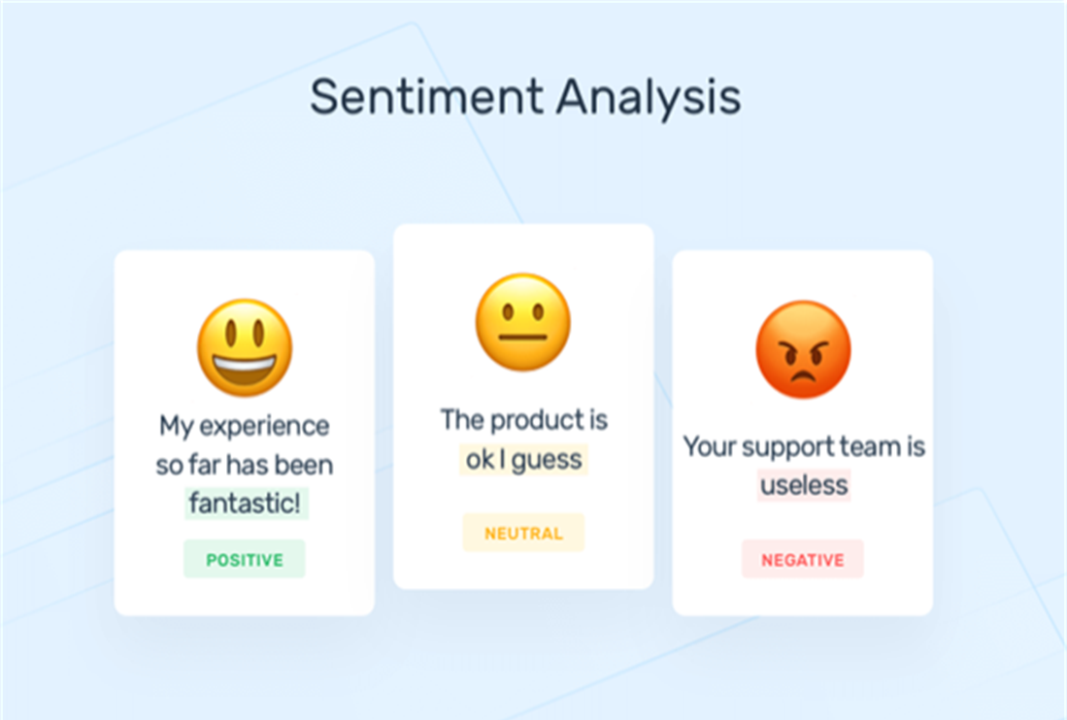
Azure NLP Sentiment Analysis​
Sentiment analysis is the process of using natural language processing, text analysis, and statistics to analyze customer sentiment.

Slide 5
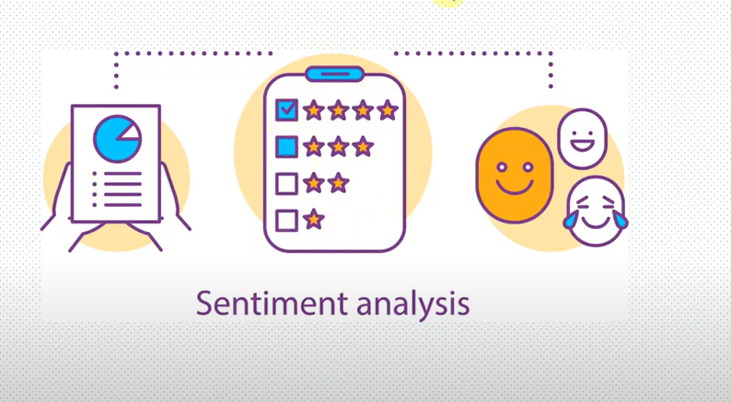
Importance of Sentiment Analysis
According to the survey, 90% of the world’s data is unstructured. Especially in businesses, emails, tickets, chats, social media conversions, and documents are generated daily
Track customer sentiment
Plan product improvement
Prioritize Customer service issue
Target individuals to improve their service.

Slide 6

How it works
Power Automate triggers when New Email arrives to Outlook/Email.
Copies the Data from the Email Body as a string to the Natural Language processing.
NLP Machine Learning Model gives the solution in the form of True and False (Whether the mail is positive or negative in nature.)
Based on the Sentiment analysis, Bot uses the string "Postive" or "negative" it will trigger the action in Email/Outlook inbox
Bot will move positive review to positive folder in inbox and negative respectively.

Slide 7
Future use cases
Helpful for sales and services enquiry.
Can be helpful for Microsoft tools, products or any product feedback gathering.
Very helpful for customer support to identify easily and prioritize unhappy customers and their emails.

Slide 8
DEMO

Slide 9

THANK YOU

